Slide 1
Project 3 / Sliding Puzzle
Christian Lee
Arianna Perez-Guarino
Cameron Deenie Sumlin-Eskridge

Slide 2
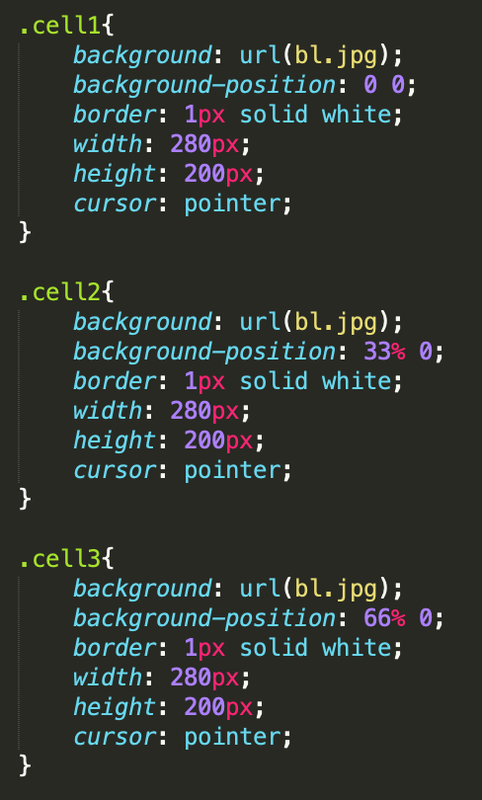
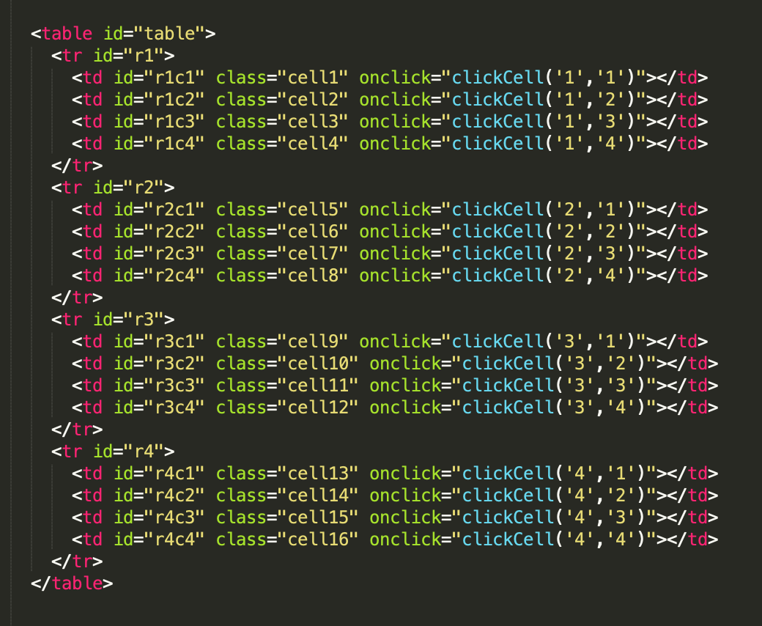
The view

Slide 3
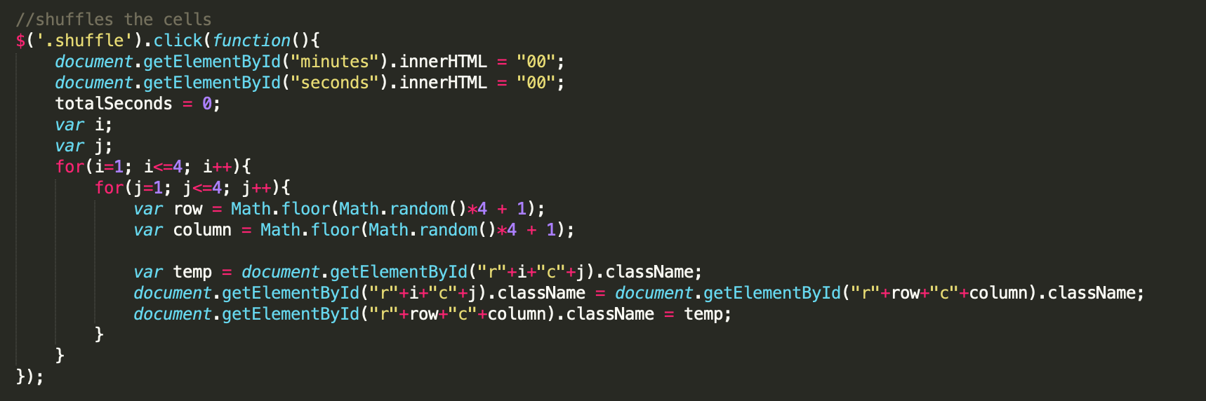
New Game / Shuffle

Slide 4
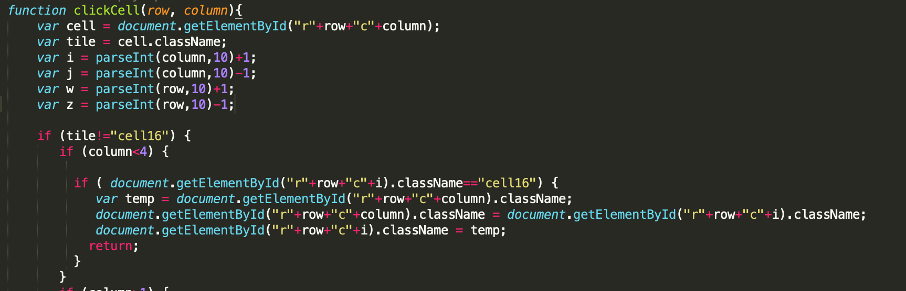
Swapping the cells

Slide 5
Changing The Backgrounds
Multiple tables were created and hidden using "display: none" in CSS.
If statements were attached to the submit button.
The statements check to see which radio is checked before displaying the corresponding table while hiding the others.

Slide 6
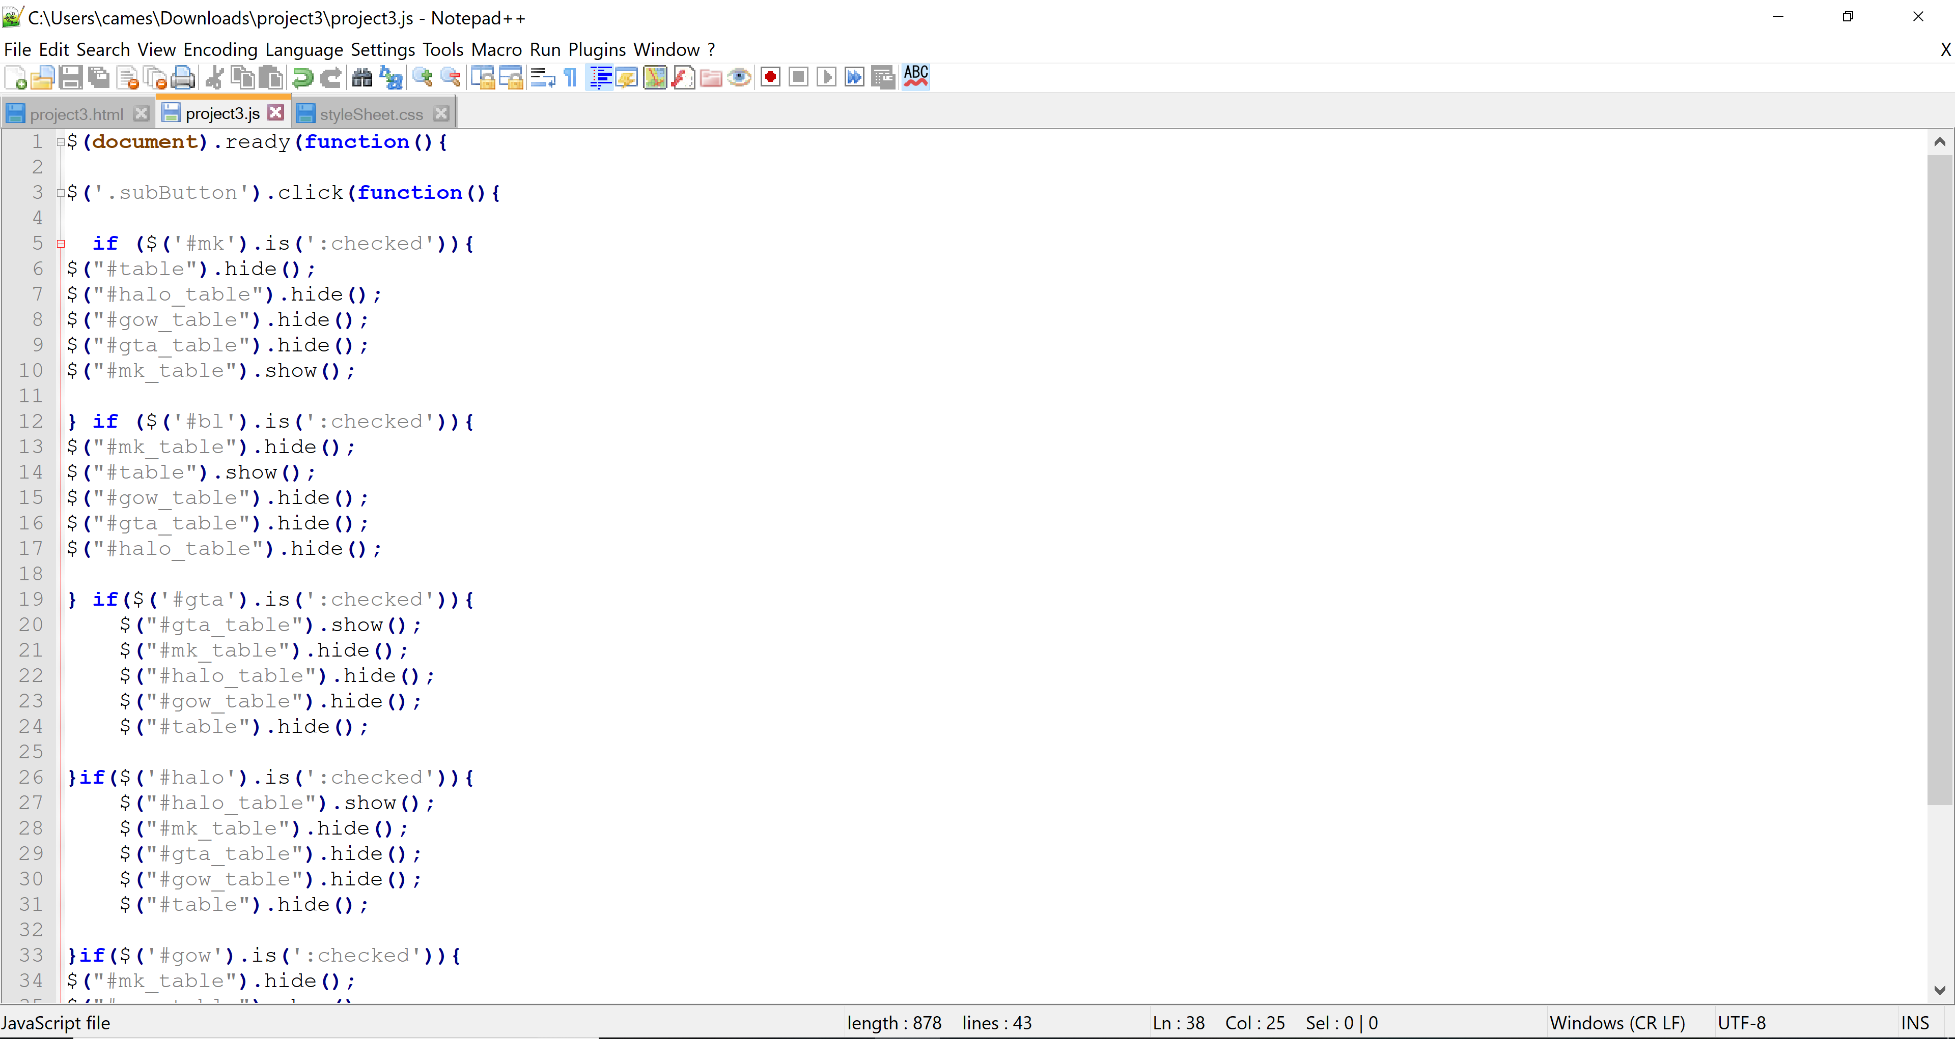

Slide 7
Time and Music
Embedding music to the page was by simply adding the audio element:
<audio controls> <source src="InsertNameHere.mp3" type="audio/mpeg"> </audio>
A basic timer was created using three variables and two functions that increment time and provide basic formatting

Slide 8
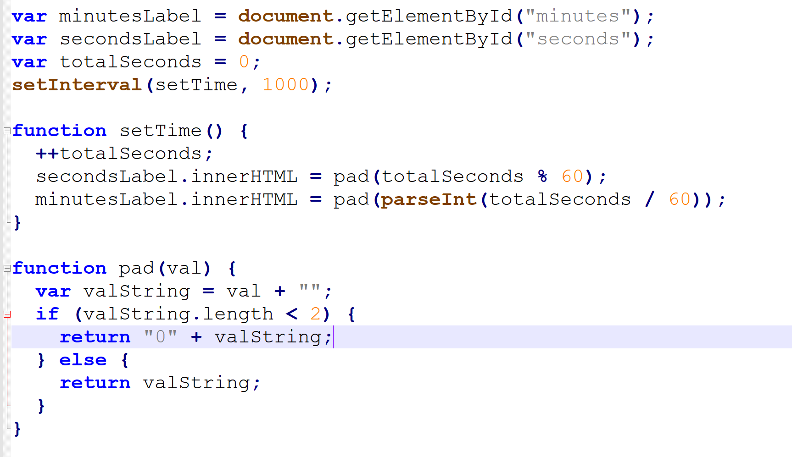

Slide 9
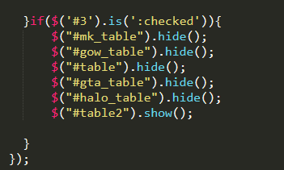
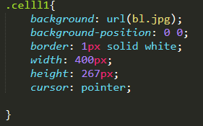
3x3 Board
Added button to allow board to be changed to a 3 x 3 layout

Slide 10


